Slide 1
Lecture 10
The STATIC keyword.
Next topics:
recursion and 2D arrays.
No lab next week ☺
I will hand out a programming project though ☹

Slide 2
STATIC has different meanings
Static Methods – “code already exists”
No need to make an instance using NEW
Static Variables – “shared variables”
One copy of variable for all object instances

Slide 3

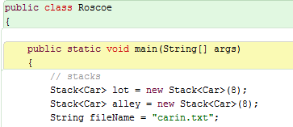

Demo: Static main vs. non-static main

Slide 4
Classes DO things and KNOW things
DO: Contain code in METHODS
Behavior of the object
KNOW: Contain attributes or variables
The methods operate on (its own) INSTANCE variables
Unless they are STATIC
Static variables are shared among all instances of a class.

Slide 5
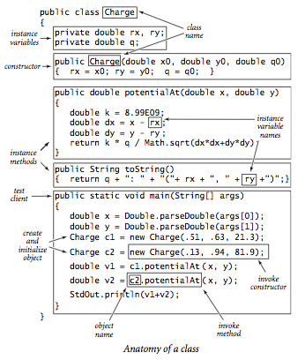
NOTE:
Each instance of Charge has its own instance variables.
Main method must create new objects of same class to access other non-static methods and instance variables.

Slide 6
Classes are like FACTORIES that produce OBJECTS.

Slide 7
Classes
Classes define a “model” object
Like a blueprint of a building
Or a mold
Or a schematic
they are models but not an actual thing
We create INSTANCES of Objects in memory by using the NEW operator

Slide 8
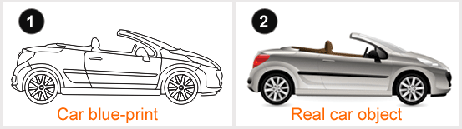
The new Operator
Car car1 = new Car(“Miata”, “123-ABC”)
Car car2 = new Car(“Prius”, “286-MINE”)
Normally, each car has its OWN SET of instance variables:
car1: model: “Miata”, license: “123-ABC”
car2: model: “Prius”, license: “286-MINE”
What if we needed to know the serial number of the last car produced, so we can increment it for the next car? This is the responsibility of the Car class, not the application. Roscoe STATIC demo.

Slide 9
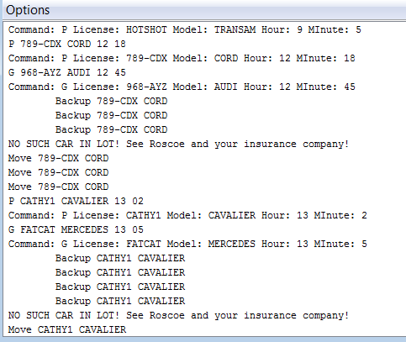
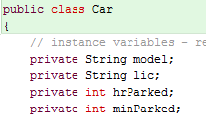
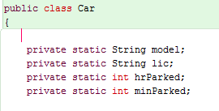
Objects
Are INSTANCES of a Class.
Each object has the methods of the Class
Each object has it OWN copy of Instance Variables (unless it is STATIC).

Slide 10
What’s all the static ?
STATIC variables are shared among ALL instances of the class (one copy).
Class Widget { static int numwidgets = 0;
… Widget( ) { numwidgets++; … }
STATIC methods do not need to be instantiated:
Public static void main (String[ ] args) …
Double x = Math.pow(2.0,3.0); // 2 cubed
Java does not have an exponentiation operator

Slide 11
Static Variables
There is only one SHARED copy of a static variable for all objects of a class
The reserved word static is used as a modifier to declare a static variable:
private static int nextSerial = 1001;

Slide 12
Static Methods
A static method can be invoked through the class name without having to instantiate an object of the class
For example:
System.out.println(“Square root of 27: “ + Math.sqrt(27));
They can only access static data:
Car.setSerialNumber(23456);

Slide 13
STATIC METHOD RULES
Do not need to be instantiated to exist.
Usually the MAIN method:
public static void main( )
Static methods can only call other static methods and access only static variables…
until other object instances can be created, then we can access those methods and instance variables. See “charge” slide.

Slide 14
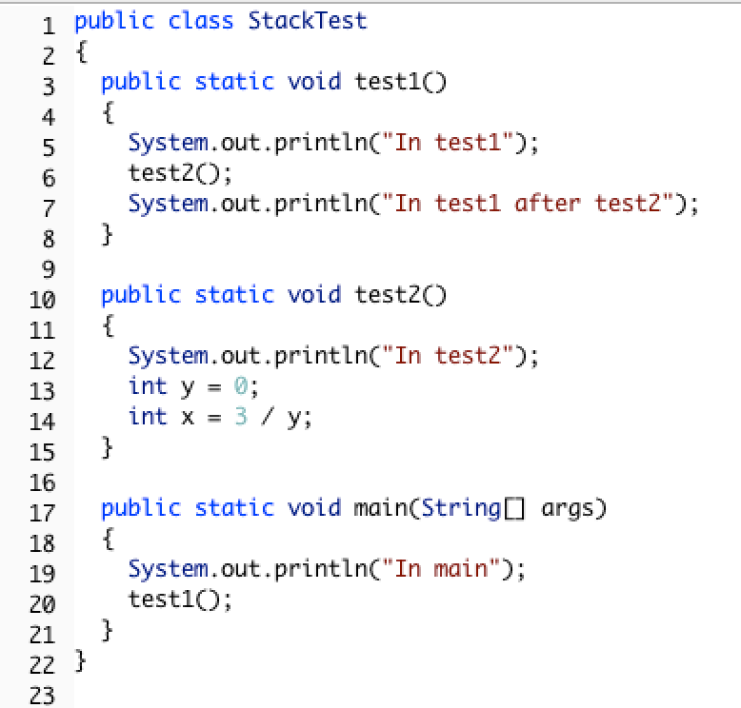
Static methods can call other static methods directly, otherwise: make a new instance and call its non-static methods
// static method calling non-static method
public class Test
{
public void test1( )
{ System.out.print(“Test1”); // non-static method
}
// make a new instance of the same class
// call non-static methods in new instance
public static void main(String[ ] args)
{ System.out.println(“Main”);
Test myTest = new Test( );
myTest.Test1( );
}

Slide 15
Review
What is the difference between instance variables and static variables?
What is the difference between a non-static method and a static method?
What is a restriction about static methods?

Slide 16
Question 7: (5 points) Modify the following program to allow the static main program to call methodA and methodB without compile errors. Do not add or change any code except in main. You may declare variables.
public class ExamStatic
{ private int x;
public void methodA() { x = 0; }
public void methodB() { x = 1; }
public static void main() {
System.out.println("Start.");
// put your code here to call nonstatic methods methodA then methodB.
System.out.println("Done.");
} }

